Slide 1
B. Tech. Project
Data Driven Modelling of Composites
End-Term Evaluation
Advisor -
Prof. Siladitya Pal
Aman Shrivastava - 13117008
Mihir Ujjwal Rana - 13117044
Yash Sharma - 13117079

Slide 2
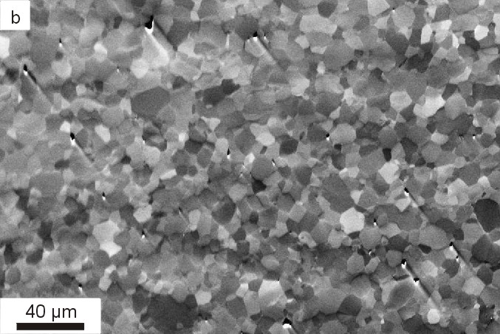
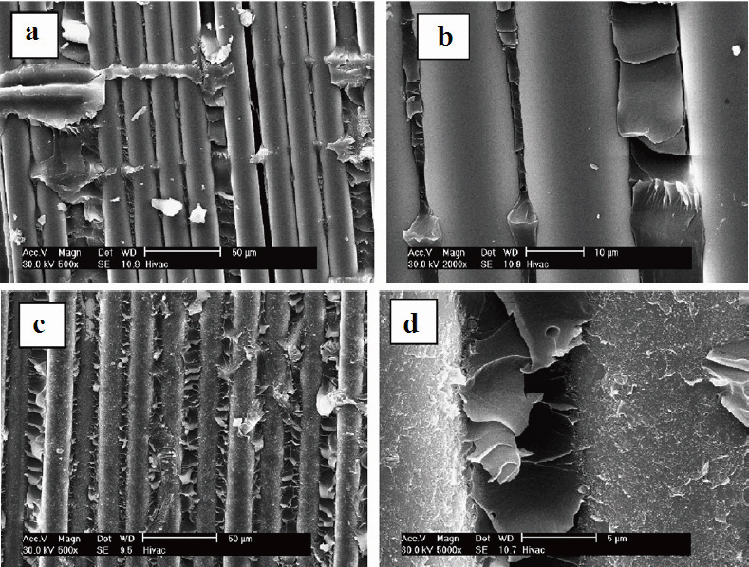
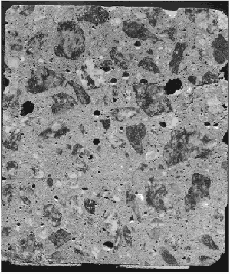
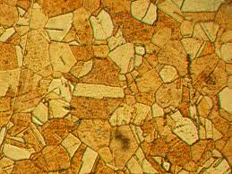
Composites
Fiber Reinforced Polymer (FRP)
Concrete

Slide 3
Behaviour of Composites
Macroscopic mechanical behavior originates from mechanics of underlying microstructure
Key mechanical performances of materials:
Elastic moduli
Toughness
Ductility
Fracture resistance
Hardness
Microstructural parameters that influence the macroscopic behaviors:
Shape (Assumed circular in our analysis)
Size
Spatial arrangement
Volume fraction and properties of constituents of the microstructure

Slide 4

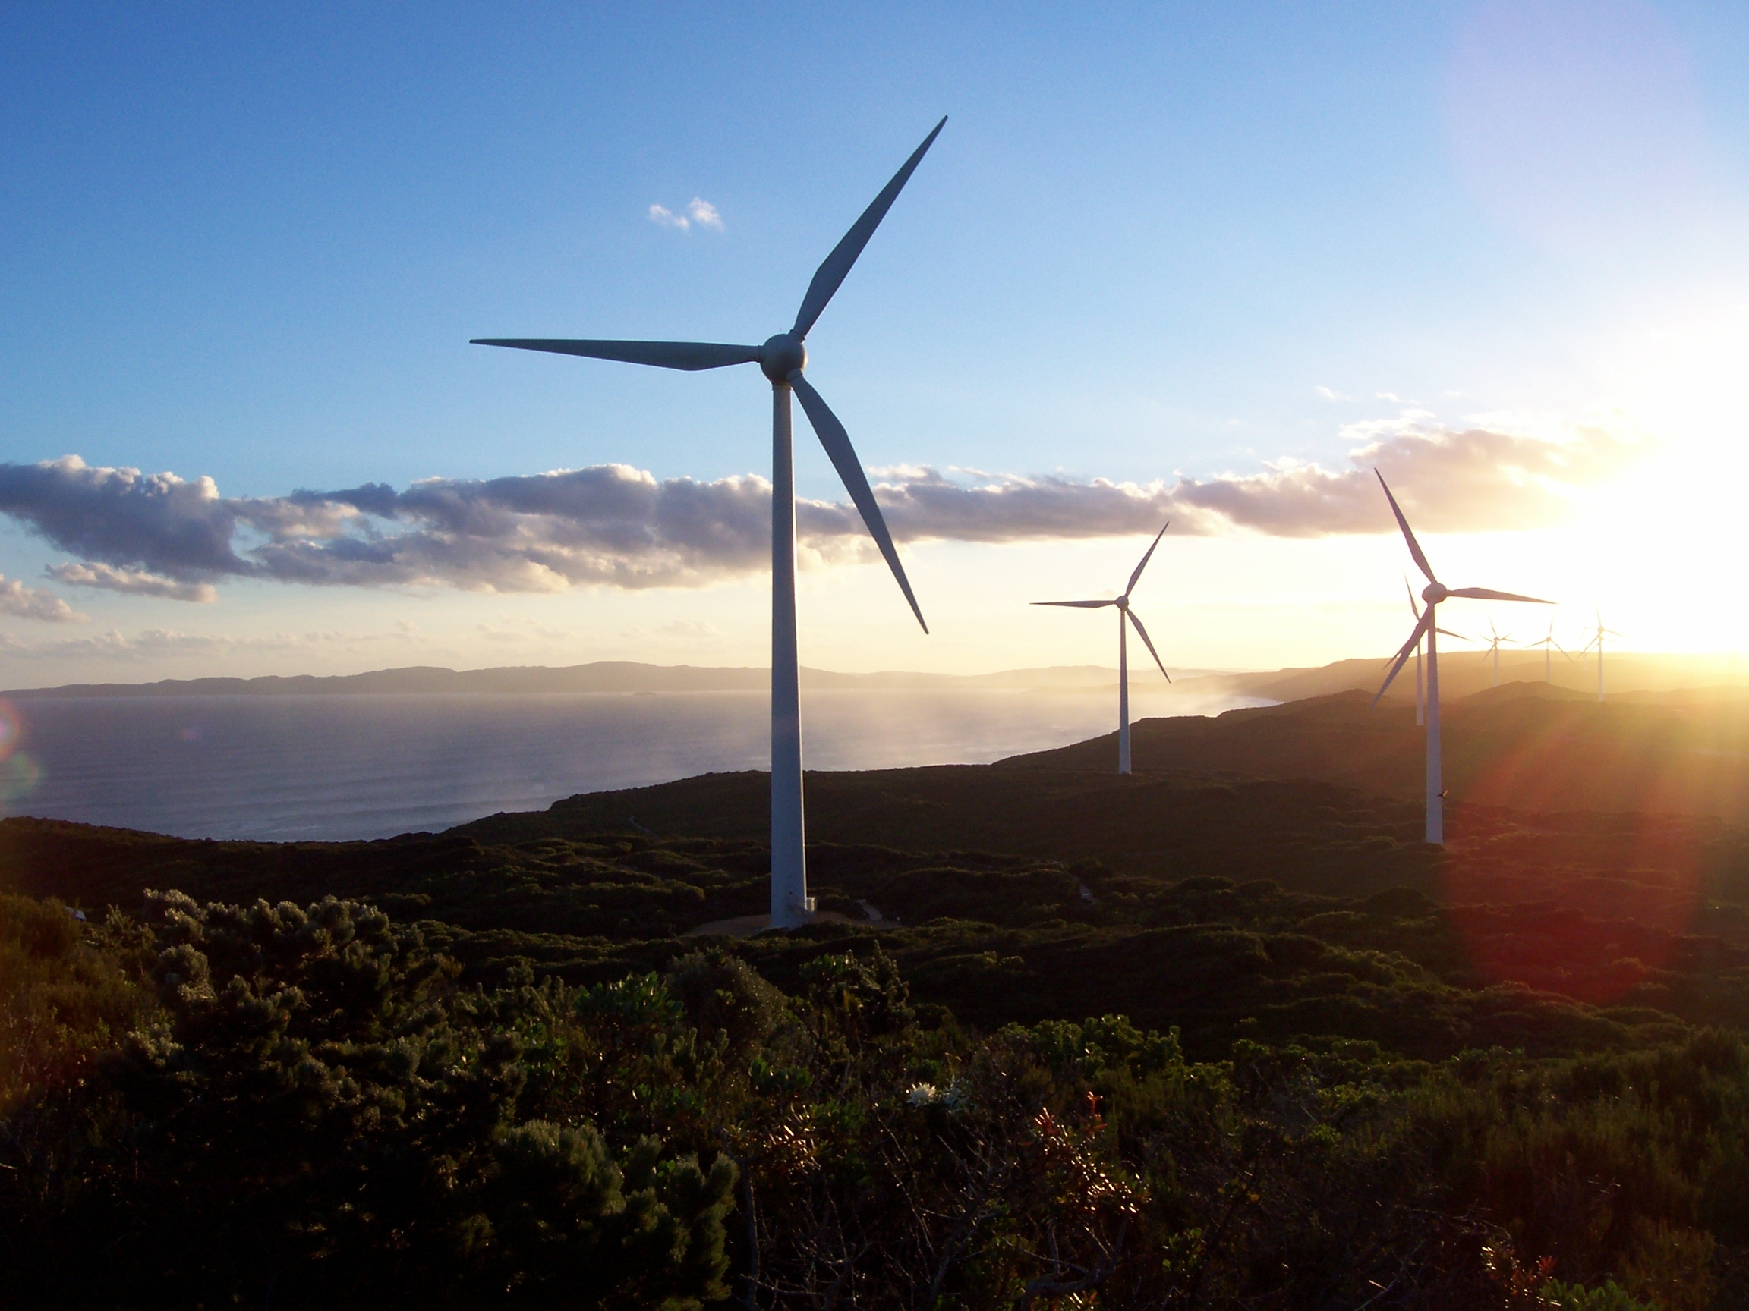

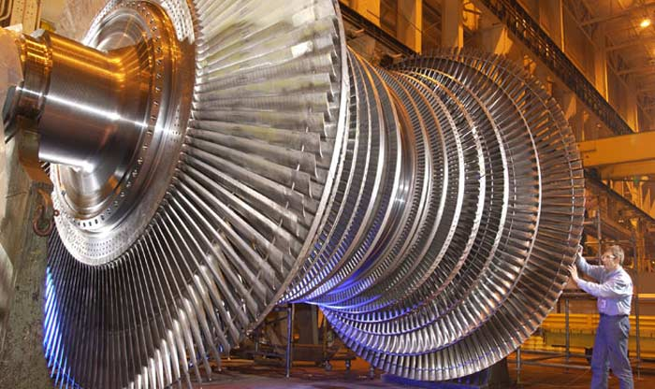
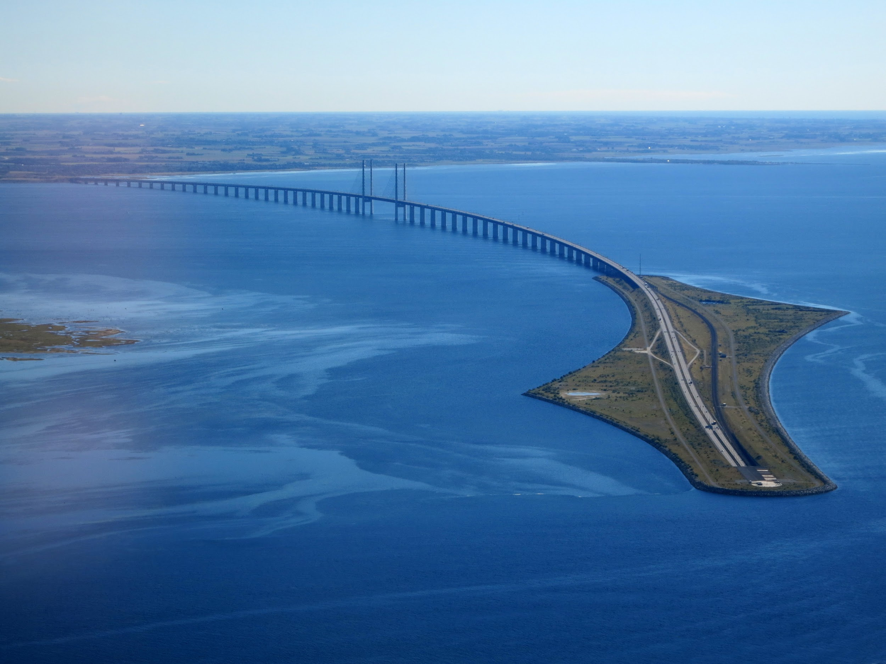
Applications
Aerospace Industry
Wind Turbine
Automobile Industry
Automobile Industry
Concrete

Slide 5
Objective
To develop an algorithmic framework to predict properties of composites to aid in meta-modelling process.

Slide 6
Why Data-Driven?
Traditional methods like ‘Rule of Mixture’ and ‘Micromechanics’ Theories cannot be applied for extremely non-linear materials (like Tyres), and the distribution of particles.
Simulations are relatively more complicated. The methodology developed requires more effort as compared to Machine Learning based approaches.
Simulations are also computationally expensive, especially when being done for a huge range of materials with variations in all properties for each material.
Data driven models are computationally much cheaper, and easier to develop.
These models rely on data, which is already available in most laboratories sitting idle. We can make use of this past data to make accurate future predictions.
These models attain nearly the same (if not higher) degree of accuracy as compared to direct FE simulations.

Slide 7
Methodology
FE Model development for simulation of mechanical behaviour of particulate composites.
Create input database based on several mechanical properties, like Young’s Modulus, Poisson’s Ratio, Volume Fraction, spatial arrangements of particles, etc.
Perform simulations and extract stress-strain behaviour for several cases.
Create a meta-model using Machine Learning algorithms.
Generate composites with unknown material properties.
Predict with meta-model, and validate the results with direct FE simulations.

Slide 8
General Workflow Structure
1. (a) Images
2. Structure Factor
3. Master Data
1. (b) Simulated Data
6. Trained Model
5. Machine Learning
4. Preprocessed Data
7. Predictions
8. Validation

Slide 9
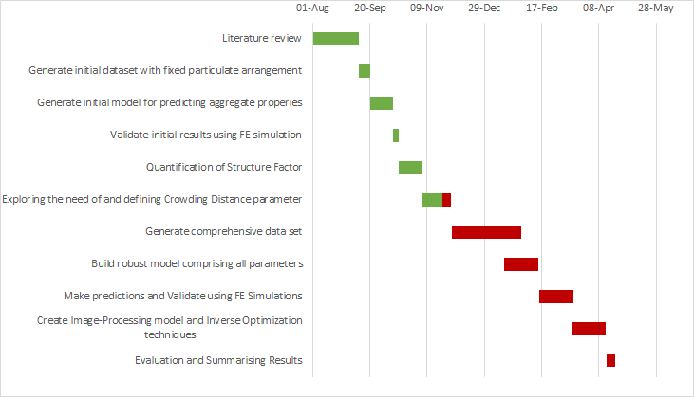
Project Timeline

Slide 10
Progress Made
Database Generation
Structure Factor Quantification
ML Model Generation
Generation of database comprising several particulate composites with different properties
Creation of parameter to quantify difference in composites with same properties and volume fraction but different spatial arrangement of particles
Generation of meta-model using Machine Learning algorithms
Making predictions using this model

Slide 11
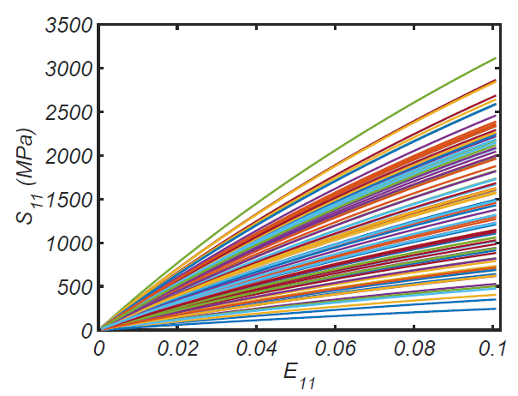
Given Data (Stress vs. Strain Graphs)

Slide 12
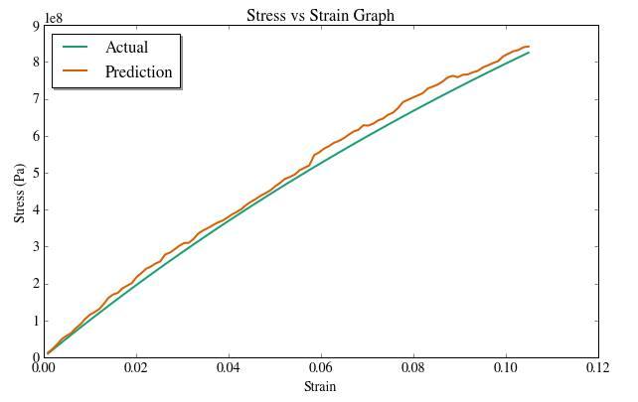
Preliminary Results (Fixed Particle Arrangement)

Slide 13
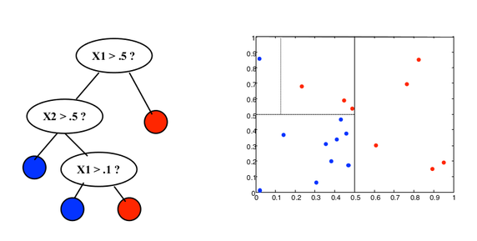
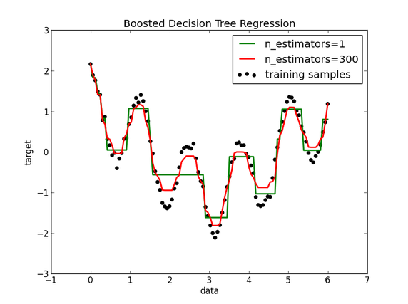
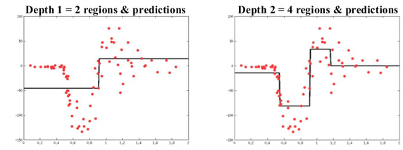
Machine Learning

Slide 14
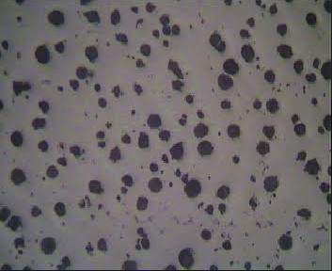
Structure Factor Quantification

Slide 15
Difference?
(i)
(ii)
(iii)

Slide 16
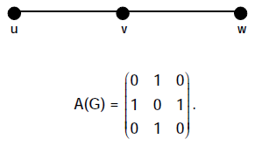
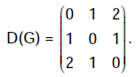
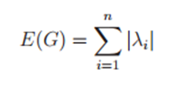
Distance Energy
The D-eigenvalues of a graph G are the eigenvalues of its distance matrix D , and the D-energy E_{D}(G) is the sum of the absolute values of its D-eigenvalues.
Two graphs are said to be D-equienergetic if they have the same D-energy. It has been proved that there exist pairs of non-D-cospectral D-equienergetic graphs of order n for every n ≥ 6 .

Slide 17
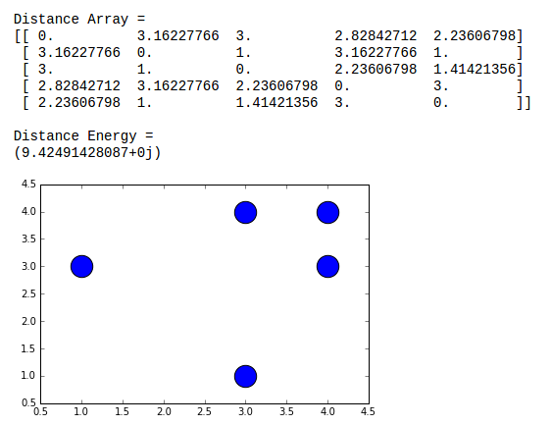
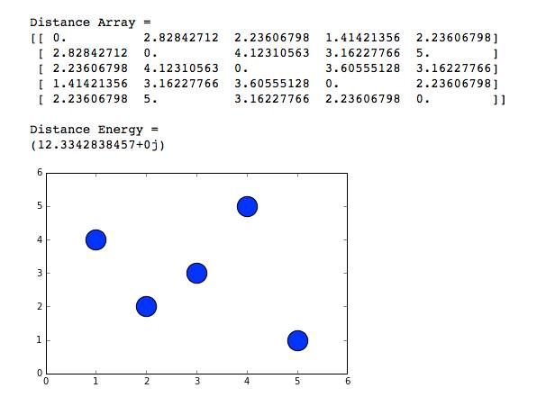
Distance Energy
Sample Computation for Two Configurations of a 5 particle system

Slide 18
D-Energy of both are equal. Thus, we need to define another parameter.
Need for Crowding Factor Quantification
It has been proved that there exist pairs of non-D-cospectral D-equienergetic graphs of order n for every n ≥ 6.
This means that whenever n ≥ 6, there exists at least one pair of arrangements where D-energies are equal.
To distinguish between these arrangements, we need one more parameter.
This parameter can be defined in terms of Crowding Distance of particles.

Slide 19
Activities to be Followed
Generation of large database spanning across various types of materials with information about exact location of all particles.
Creation of a parameter to quantify crowding of particles within a sample to distinguish between equi-energetic distributions.
Implement alternative definition of Structure Factor using Fourier transformation techniques to check if results improve.
Validation of model by comparison with direct FE simulation, according to an appropriate confidence interval band.
Generation of an Image-Processing based engine to directly identify all particles and their respective locations from image for inputting in the ML model.
Definition of Inverse Optimization techniques to recommend materials and particulate arrangement, given target properties such as strength or structure factor.

Slide 20
Additional Help Required
High performance workstations are a must for our efforts to fructify. We would need high parallel-computing power (available in our advisor’s office and at the ICC).
Since the validation process comprises comparison with real data, we would need FE simulated data to compare the material properties with our predictions. Simulations would primarily be handled by our advisor.
If time permits, we would also be doing experimental validation by testing on loaded materials in a laboratory.

Slide 21
References
Balakrishnan R., The Energy of a Graph Linear Algebra and Its Applications, 387, (2004), 287-295.
N. Murugesan, K. Meenakshi, Skew Energy of Digraphs and Relation Between Graph Energy and Distance Energy, International Journal of Combinatorial Graph Theory and Applications (2011), 161-174
Agrawal, Ankit, Choudhary Alok, Perspective: Materials informatics and big data: Realization of the “fourth paradigm” of science in materials science, APL Materials (2016)
Balachandran Prasanna, Xue Dezhen, Theiler James , Adaptive Strategies for Materials Design using Uncertainties, Scientific Reports (2015)
Doreswamy, Hemanth. K. S, Performance Evaluation of Predictive Classifiers For Knowledge Discovery From Engineering Materials Data Sets, CiiT Journal (2003)
Xue Dezhen, Balachandran Prasanna,Hogden John, Accelerated search for materials with targeted properties by adaptive design, Nature (2016)

Slide 22
Thank You!
Any Questions?

